Slide 1
Data Link Layer

Slide 2
Data Link Layer
The physical layer provides only a raw bit-stream service, the data link layer attempts to make the physical link reliable while providing the means to activate, maintain, and deactivate the link .
This layer is responsible for the error-free transfer of data frames.
It defines the format of the data on the network.
It provides a reliable and efficient communication between two or more devices.
It is mainly responsible for the unique identification of each device that resides on a local network.

Slide 3
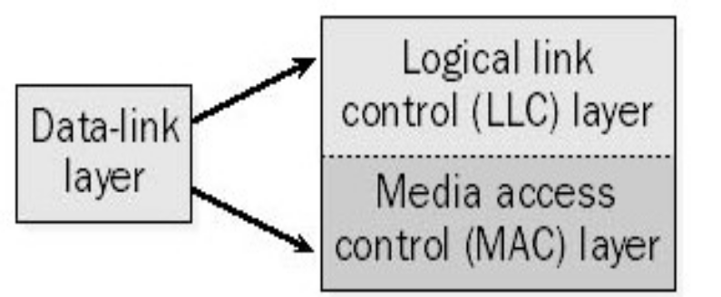
For LANs, the Project 802 standards of the Institute of Electrical and Electronics Engineers (IEEE) separate the data-link layer into two sublayers:
  Logical Link Control Layer
  Media Access Control Layer

Slide 4
The logical link control (LLC) layer, the upper of the two layers, which is responsible for flow control, error correction, and resequencing functions for connection-oriented communication, but which also supports connectionless communication.
It is responsible for transferring the packets to the Network layer of the receiver that is receiving.
It identifies the address of the network layer protocol from the header.

Slide 5
The media access control (MAC) layer, the lower of the two layers, which is responsible for providing a method for stations to gain access to the medium.
A Media access control layer is a link between the Logical Link Control layer and the network's physical layer.
It is used for transferring the packets over the network.

Slide 6
Functions
Provides a well-defined service interface to the network layer.
Performs general link layer management.
Framing - Determines how the bits of the physical layer are grouped into frames
Physical addressing
Error control - Deals with transmission errors (CRC, ARQ).
Flow control - Regulates the flow of frames.
Access control - Determines which device has control over the link at any given time

Slide 7
End to End
ACK/NAK
1
2
3
4
5
Data
Data
Data
Data
Hop by Hop
Data
Data
Data
Data
1
2
3
4
5
ACK/NAK
ACK/NAK
ACK/NAK
ACK/NAK

Slide 8
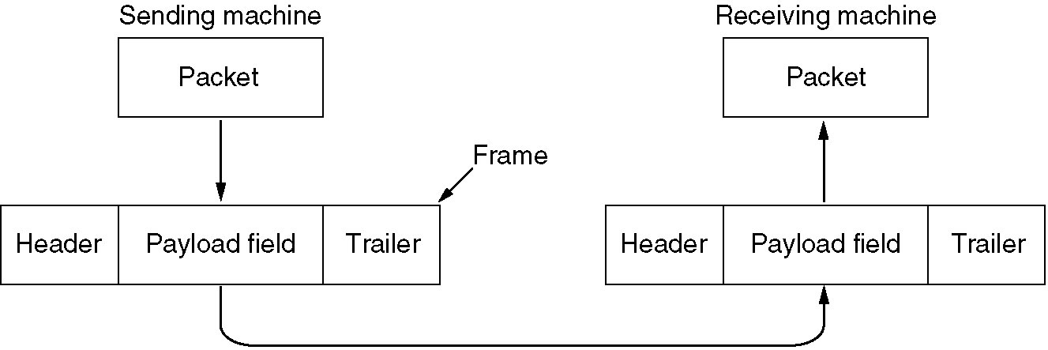
Functions of the Data Link Layer
Relationship between packets and frames.

Slide 9
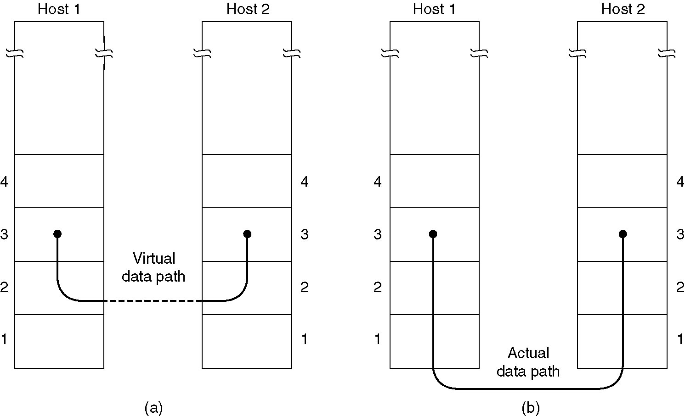
Services Provided to Network Layer
(a) Virtual communication.
(b) Actual communication.

Slide 10
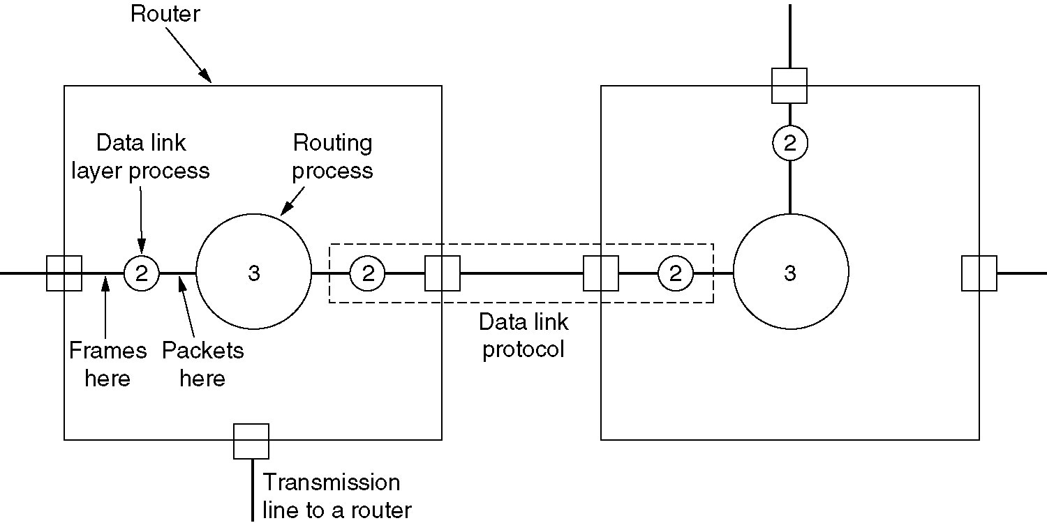
Placement of DLL
Placement of the data link protocol.

Slide 11
Types of services provided to the Network Layer
Unacknowledged Connectionless service
Acknowledged Connectionless service
Acknowledged Connection-Oriented service

Slide 12
Unacknowledged Connectionless service
Losses are taken care of at higher layers
Used on reliable medium like coax cables or optical fiber, where the error rate is low.
Appropriate for voice, where delay is worse than bad data.

Slide 13
Acknowledged Connectionless service
Useful on unreliable medium like wireless.
Acknowledgements add delays.
Adding ack in the DLL rather than in the NL is just an optimization and not a requirement. Leaving it for the NL is inefficient as a large message (packet) has to be resent in that case in contrast to small frames here.
On reliable channels, like fiber, the overhead associated with the ack is not justified.

Slide 14
Acknowledged Connection-oriented service
Most reliable,
Guaranteed service –
  Each frame sent is indeed received
  Each frame is received exactly once
  Frames are received in order
Special care has to be taken to ensure this in connectionless services

Slide 15
Framing
Character Count/ Byte Count
Flag bytes with byte stuffing
Flag bytes with bit stuffing
Physical layer coding violations.

Slide 16
Framing with Character count
uses a field in the header to specify the number of bytes in the frame.
When the data link layer at the destination sees the byte count, it knows how many bytes follow and hence where the end of the frame is.

Slide 17
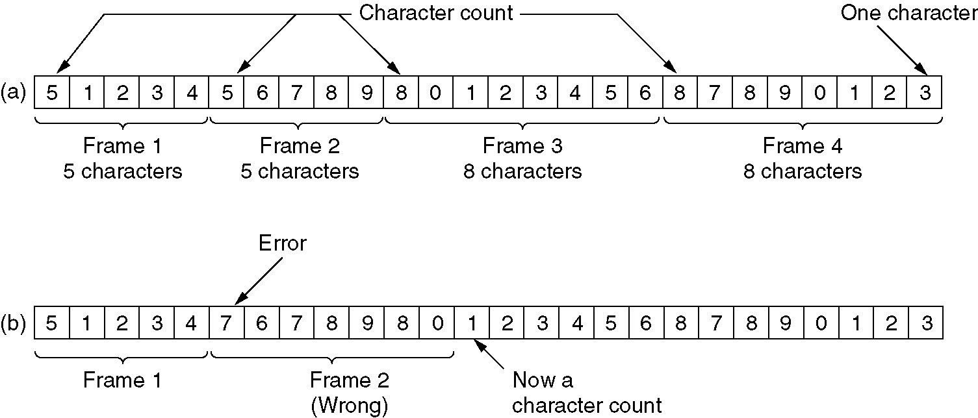
A character stream. (a) Without errors. (b) With one error.

Slide 18
Problem with Framing with CC
What if the count is garbled by a transmission error
  if the byte count of 5 in the second frame of Fig. 3-3(b) becomes a 7 due to a single bit flip, the destination will get out of synchronization. It will then be unable to locate the correct start of the next frame.
Even if with checksum, the receiver knows that the frame is bad there is no way to tell where the next frame starts.
Asking for retransmission doesn’t help either because the start of the retransmitted frame is not known
No longer used

Slide 19
Framing with byte stuffing
Gets around the problem of resynchronization after an error by having each frame start and end with special bytes.
The same byte, called a flag byte, is used as both the starting and ending delimiter.
Two consecutive flag bytes indicate the end of one frame and the start of the next. Thus, if the receiver ever loses synchronization it can just search for two flag bytes to find the end of the current frame and the start of the next frame.

Slide 20
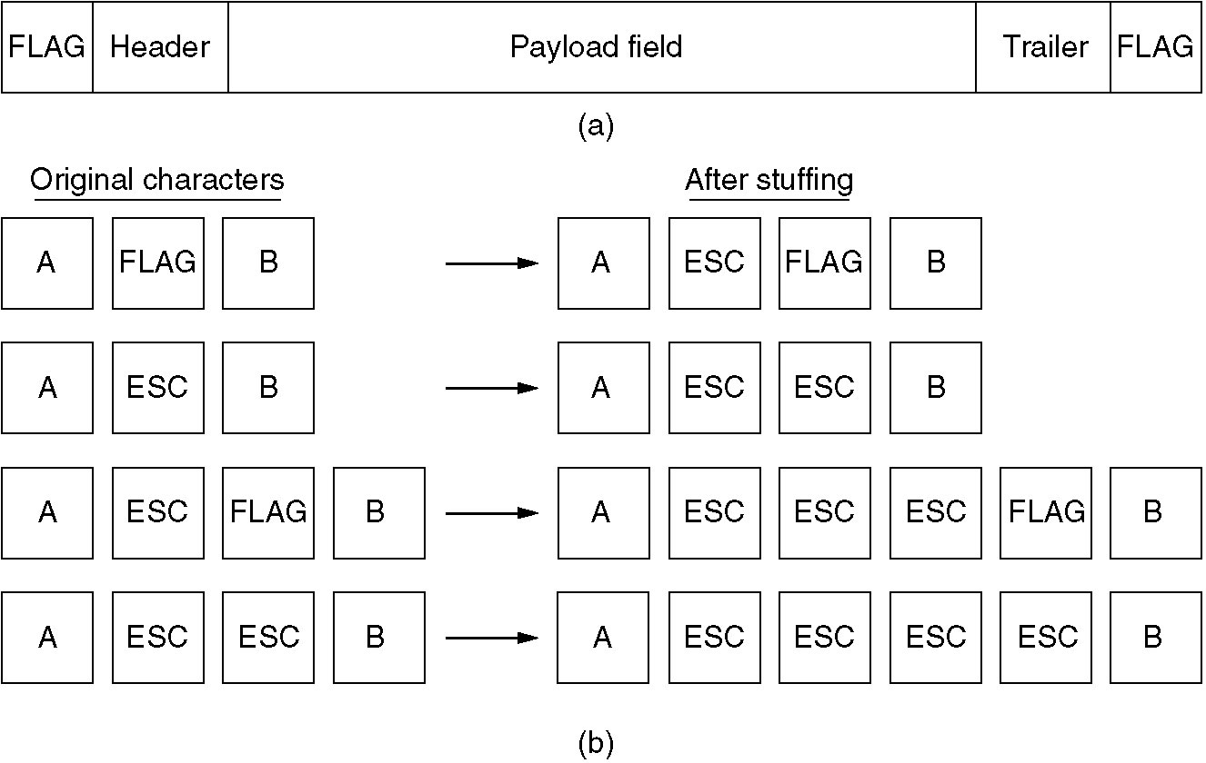
(a) A frame delimited by flag bytes.
(b) Four examples of byte sequences before and after stuffing.

Slide 21
Framing with byte stuffing
Problem
fixed character size - assumes character size to be 8 bits
can’t handle heterogeneous environment.

Slide 22
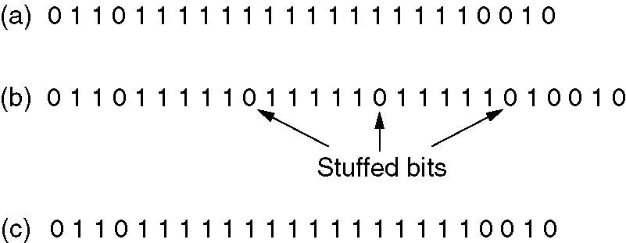
Framing with bit stuffing
Bit stuffing
(a) The original data.
(b) The data as they appear on the line.
(c) The data as they are stored in receiver’s memory after destuffing.

Slide 23
Physical Layer Coding Violations:
The encoding of bits as signals often includes redundancy to help the receiver. This redundancy means that some signals will not occur in regular data.
Reserved signals to indicate the start and end of frames.
Used only when physical medium contains some redundancy
1: high-low
0: low-high
high-high and low-low are used for delimiting frames

